Slide 1

BC2410, Prescriptive Analytics From Data to Decisions
Lecture 2

Slide 2
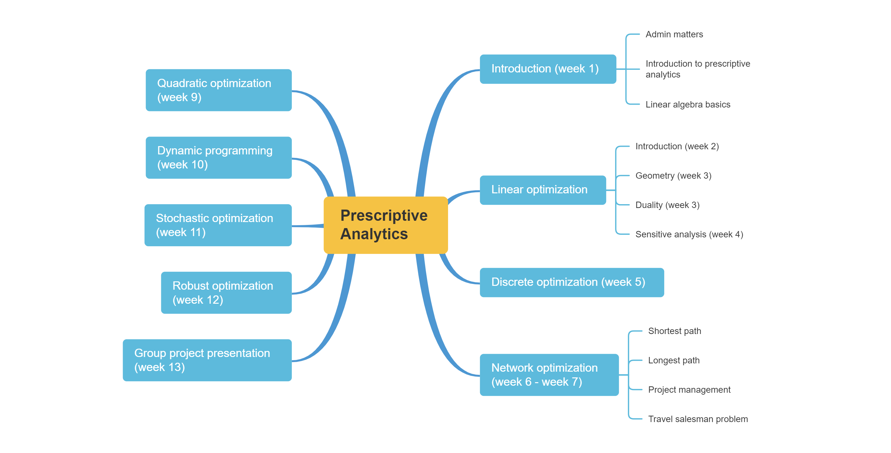
Schedule

Slide 3
Schedule

Slide 4
Linear Optimization Problem (LOP)
Decision variables, denoted by unknowns. Say, x, y, z… (or x₁, x₂, x₃)
Data, denoted by a, b, c…(parameters)
An objective function, say 2x+3y-z, to be minimized/maximized
A set of constraints, denoted by equations or inequalities

Slide 5
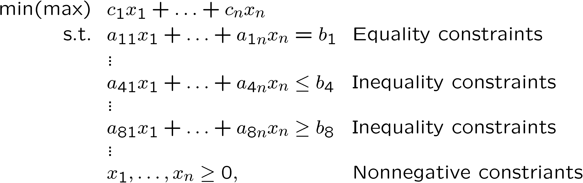
Linear Optimization Problem (LOP)
General Framework

Slide 6
Linear Optimization Problem (LOP)
General Framework
Objective:

Slide 7
Linear Optimization Problem (LOP)
General Framework
Objective:
Constraints:

Slide 8
Linear Optimization Problem (LOP)
General Framework
Objective:
Constraints:
Decision variables:

Slide 9
Linear Optimization Problem (LOP)
General Framework
Objective:
Constraints:
Decision variables:
Parameters:
Notes:
Can you write this problem in matrix form?

Slide 10
LOP Models
We maximize (or minimize) a linear function (called the objective function) of the decision variables.
Decision variables must satisfy a set of constraints. Each constraint must be a linear equation ( = ) or linear inequality ( >= or <=).
Notes:
Always follow these observations.

Slide 11
LOP Models
Usually, sign restriction is associated with each decision variable. However, a variable may be unrestricted in sign (say, temperature).
By convention, constraints are written such that all the decision variables are on the LHS, while the constant is on the RHS.

Slide 12

Optimization Software
Why we need optimization software?
Large-scale real world optimization problem
Concise and readable syntax to the mathematical notation
Easy model development, debug and maintenance
Clear output presentation
Exchange data with external sources
Data
Solution
Model
Algorithm

Slide 13
Optimization Software
Programming languages: Python, C, C++, Julia, Matlab, etc.
Algebraic Modeling Language for Optimization
A high-level computer programming languages for modeling optimization problems
E.g. AIMMS, EXCEL Solver, AMPL, RSOME
Solver
Well-established algorithms to solve the program
Cplex, Gurobi, OR-Tools, CVXPY, Mosek, SDPT3, etc.

Slide 14
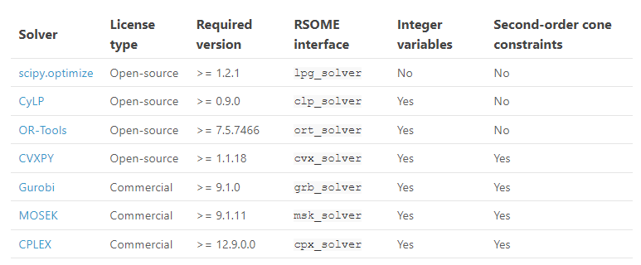
RSOME – Supported Solvers
RSOME supports a variety solvers including ORT-Tools (Google).

Slide 15

RSOME Implementation
Decision variables
Parameters
Constraints
Objective function

Slide 16
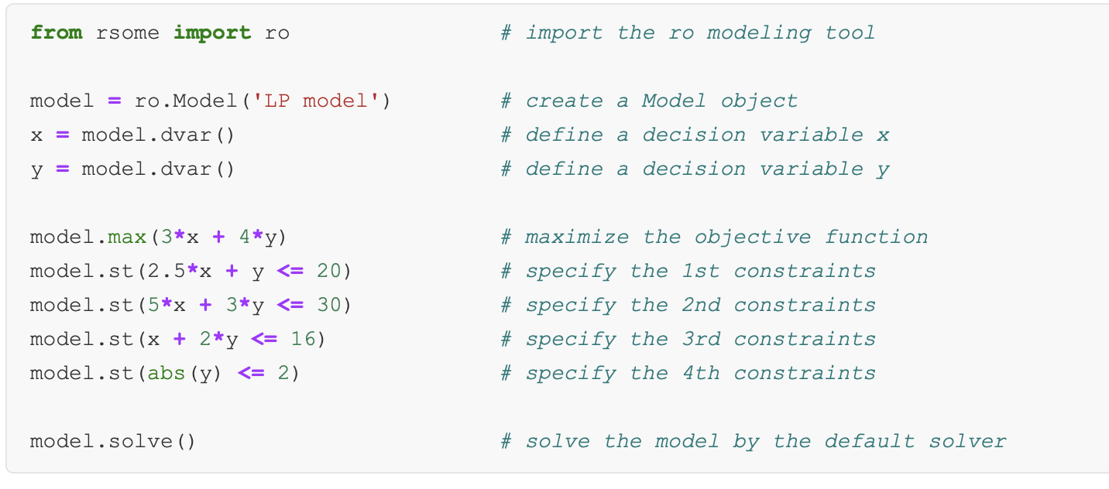
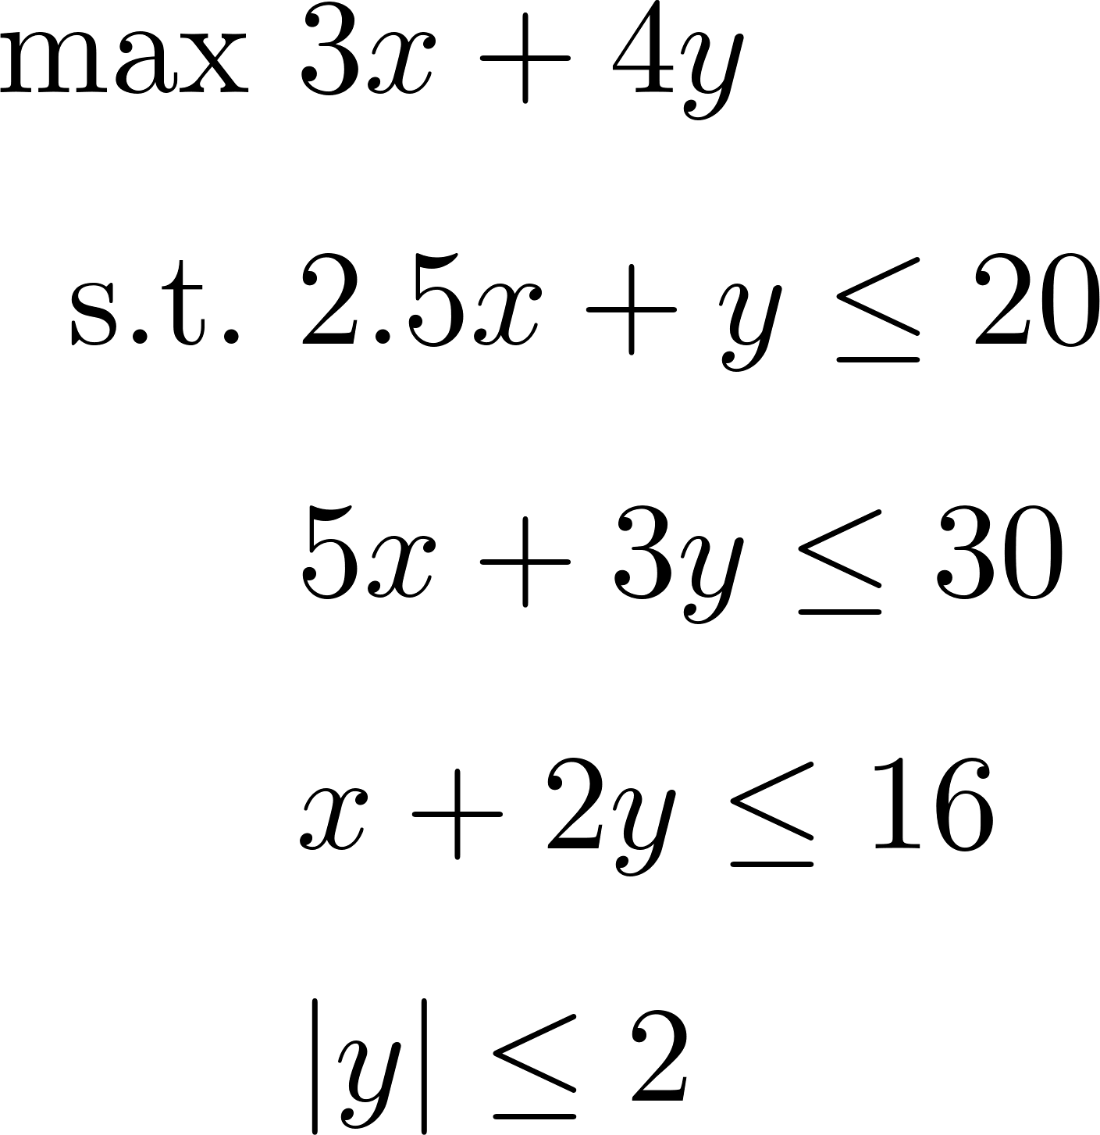
A Linear Programming Example

Slide 17
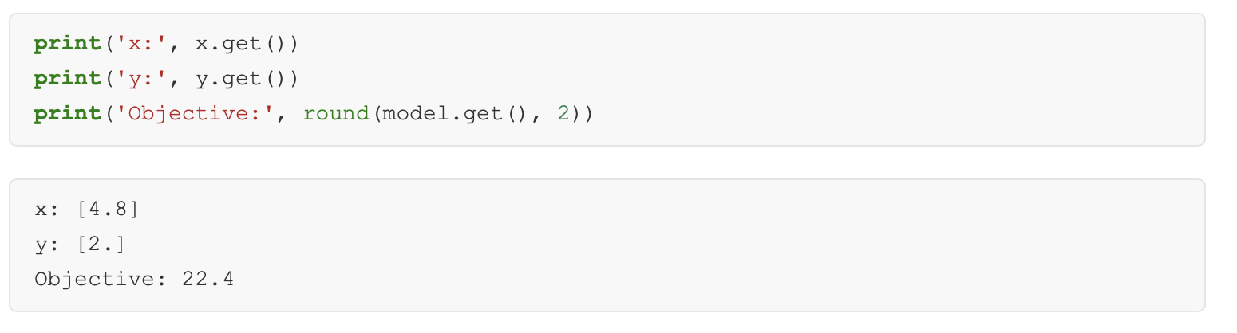
A Linear Programming Example
Notes:
Try to code it in jupyter notebook

Slide 18
Back to LOP Example:
A furniture company makes tables and chairs
Production require wood, finishing labor and carpentry labor.
 | Desk | Table | Chair | Avail.
Revenue | 60 | 30 | 20
Wood | 8 | 6 | 1 | 48
Finish Hrs | 4 | 2 | 1.5 | 20
Carpentry Hrs | 2 | 1.5 | 0.5 | 8
Notes:
Try to formulate the problem in both the traditional form and matrix form without looking solution.
Always remember to ask yourself when facing a problem:
What data we have?
What are the decisions?
What is the objective?
What are the constraints?

Slide 19
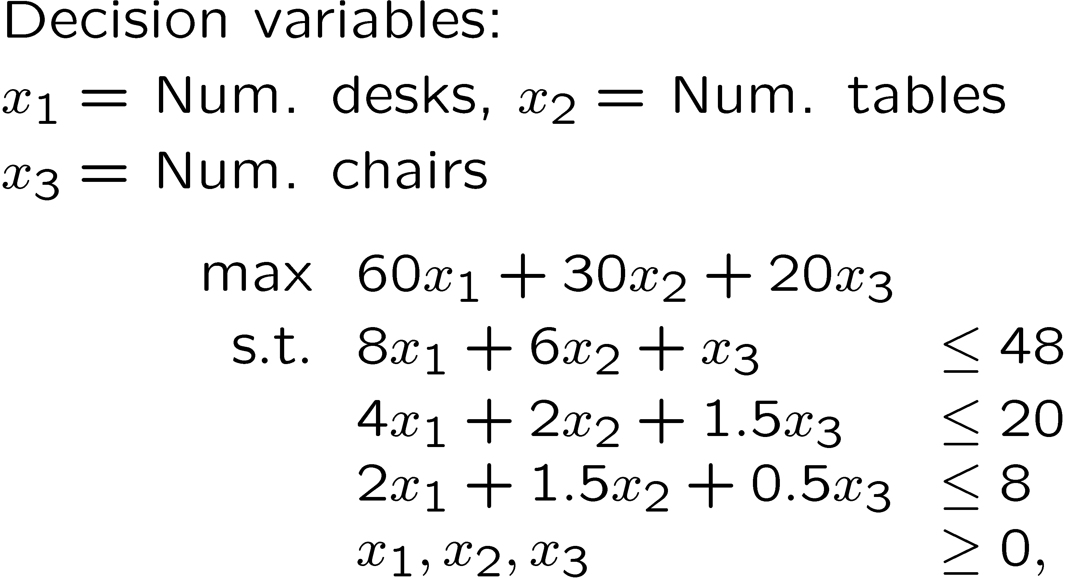
LOP Example:
Notes:
Try to code it in Jupyter Notebook

Slide 20
Manufacturing Problem
Consider a manufacturer produces n products from m raw materials. Each product j requires a_{ij} units of material i. The profit of product j is c_{j} while there are only b_{i} units of material i.
Could you assist the manufacturer in determining her production quantities?

Slide 21
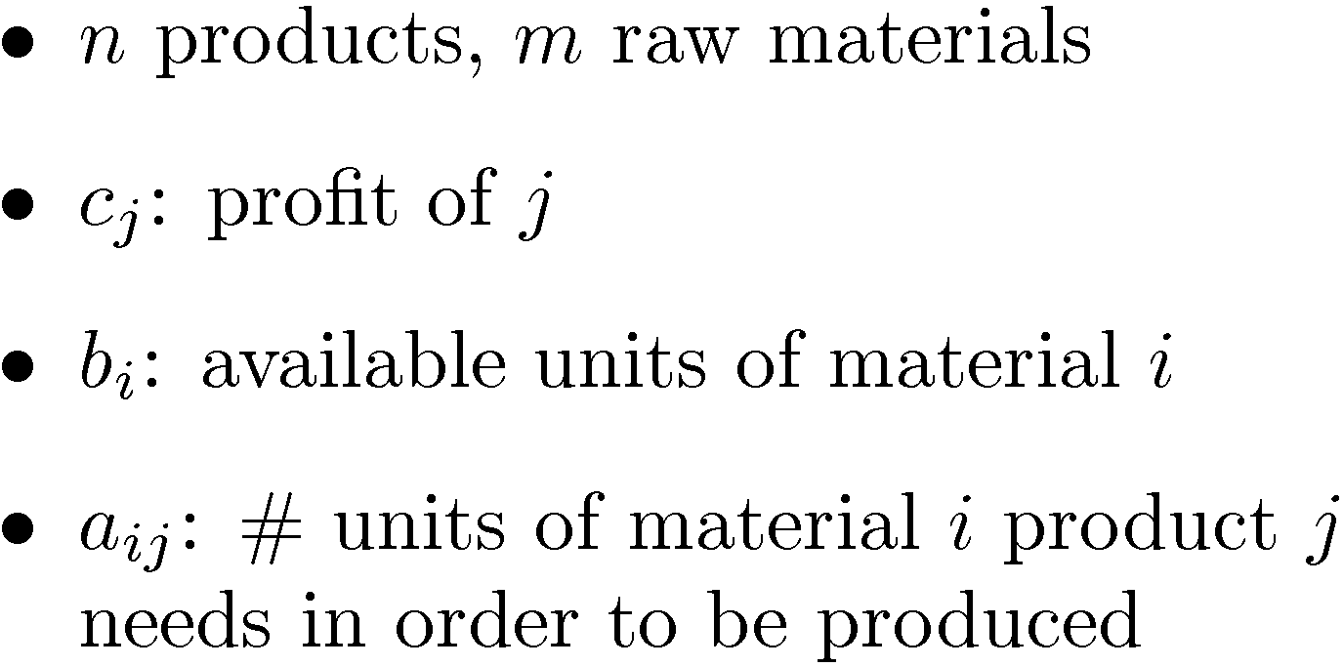
Manufacturing Problem
Data

Slide 22
Production Scheduling Problem
Regular production: $190/unit up to 160 units per week
Overtime production: $260/unit up to 50 units per week
Surplus units can be carried over to next week. Holding cost is $10/unit per week.
Find the minimum cost production schedule.

Slide 23
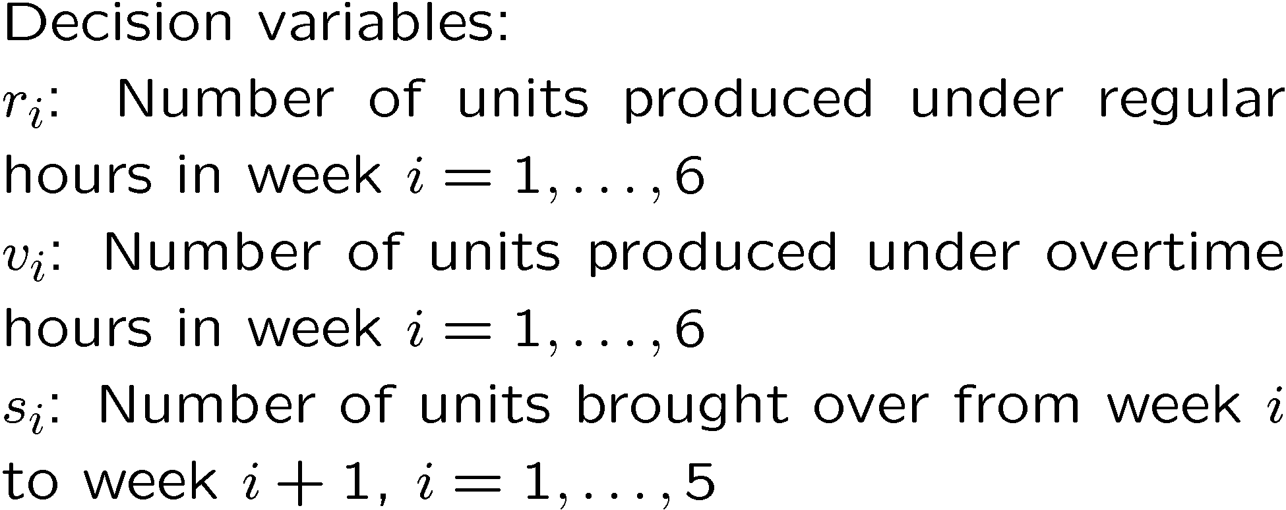
Production Scheduling Problem

Slide 24
Transportation Problem
A company has three PC assembly plants at locations, 1, 2 and 3, with monthly production capacity of 1700 units, 2000 units, and 1700 units, respectively. Their PC’s are sold through four retail outlets in locations A, B, C,D, with monthly orders of 1700 units, 1000 units, 1500 units, and 1200 units respectively.
Shipping costs ($/unit) | A | B | C | D
1 | 5 | 3 | 2 | 6
2 | 7 | 7 | 8 | 10
3 | 6 | 5 | 3 | 8

Slide 25






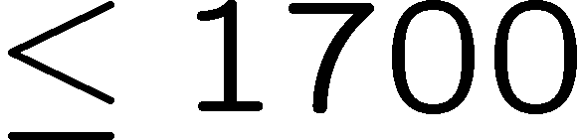

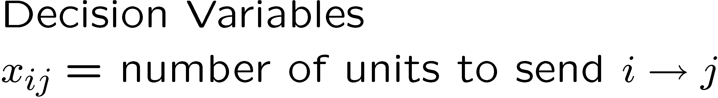
Transportation Problem
A
1
B
2
C
3
D

Slide 26
Scheduling Problem

Slide 27
Revenue Management
“We estimate that RM has generated $1.4 billion in incremental revenue for American Airlines in the last three years alone. This is not a one-time benefit. We expect RM to generate at least $500 million annually for the foreseeable future…”
Robert Crandall, former CEO of American Airlines

Slide 28
Revenue Management
The Airline industry in US
Deregulation in 1978.
Prior to Deregulation: carriers only allowed to certain routes. Hence airlines such as Northwest, Eastern Southwest etc.
Fares determined by Civil Aeronautics Board (CAB) based on mileage and other costs - (CAB no longer exists)
Post Deregulation
anyone can fly anywhere
fares determined by carrier and the market

Slide 29
Revenue Management
Economics
Huge sunk and fixed costs
Very low variable costs per passenger
$10 per passenger or less
Strong economically competitive environment
Near perfect information and negligible cost of information
Highly perishable inventory
Result: Multiple fares

Slide 30
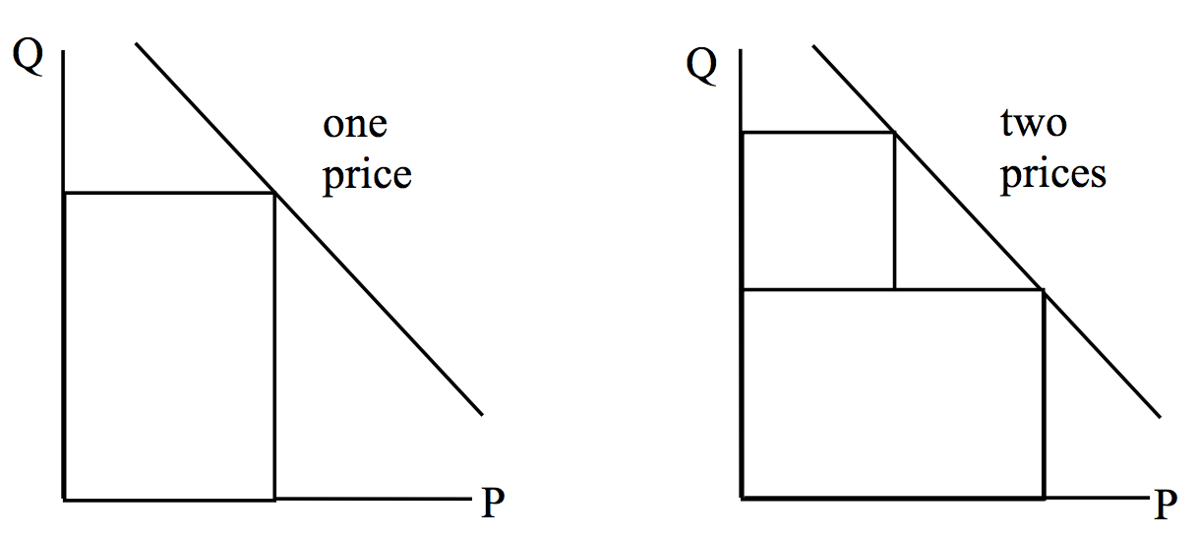
Multiple fare classes: a monopolist’s perspective
The two-fare model presumes that customers are willing to pay the higher price, even if the lower price is available. How did airlines achieve this?

Slide 31





Revenue Management
Origin, Destination and Hub
1
1
Destination
Origin
2
2
0
Hub
: :
: :
n
n

Slide 32
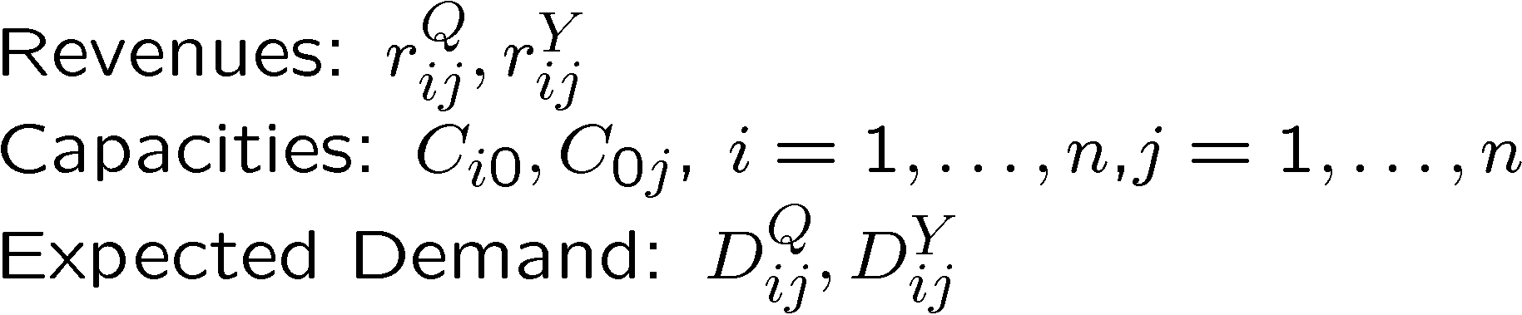
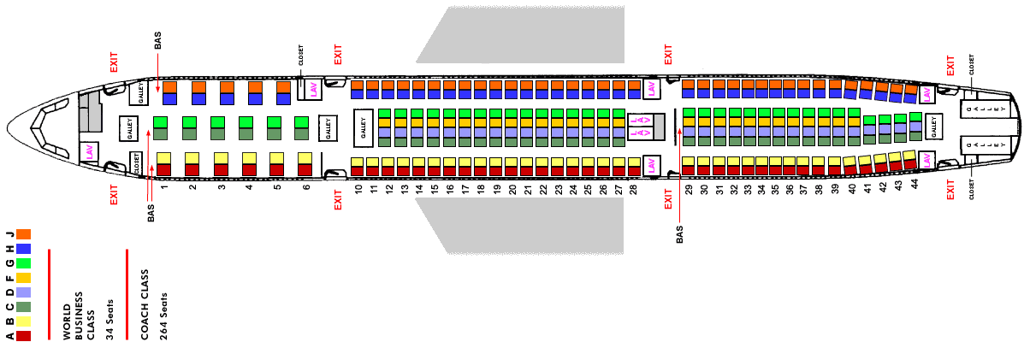
Revenue Management
2 class (for simplicity) Q and Y

Slide 33
Revenue Management
The right question asked… how many class Q and Y customers should we accept in order to maximize revenue?

Slide 34
LOP Tricks
Linearizing objective

Slide 35
LOP Tricks
Linearizing objective

Slide 36
LOP Tricks
Minimax objective

Slide 37
LOP Tricks

Slide 38
LOP Tricks
Minimax objective

Slide 39
LOP Tricks
Absolute values

Slide 40
LOP Tricks

Slide 41
LOP Tricks

